Slide 1

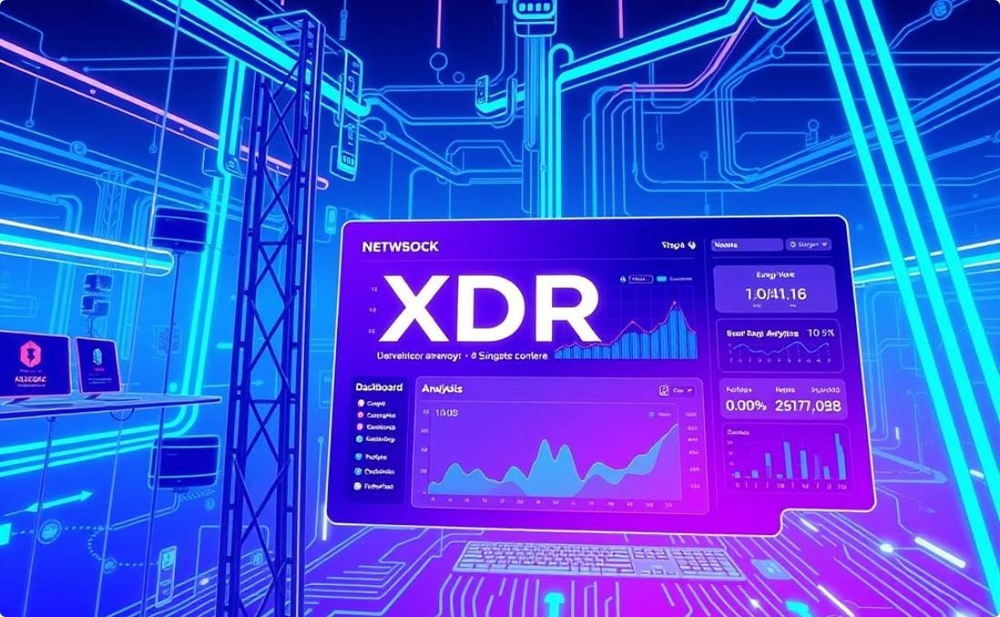



Presentation Focus
TELCO XDR User Behavior & Experience Analytics
Presented by
Deepa Pathak
Company
NeXT hikes IT Solutions
https://github.com/DataWithDeepa

Slide 2
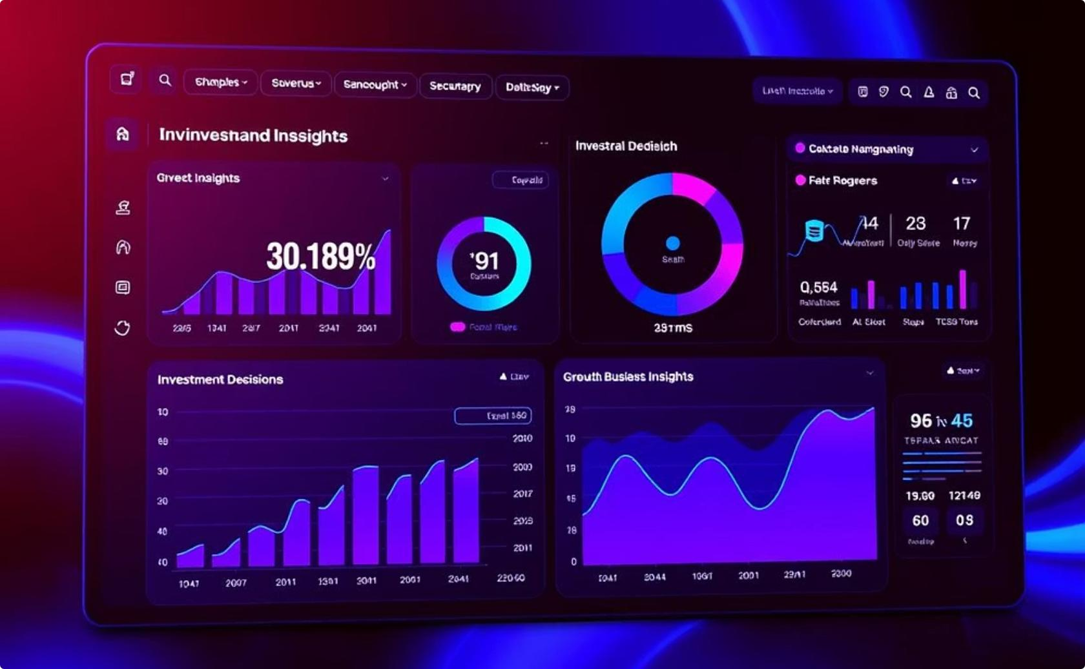
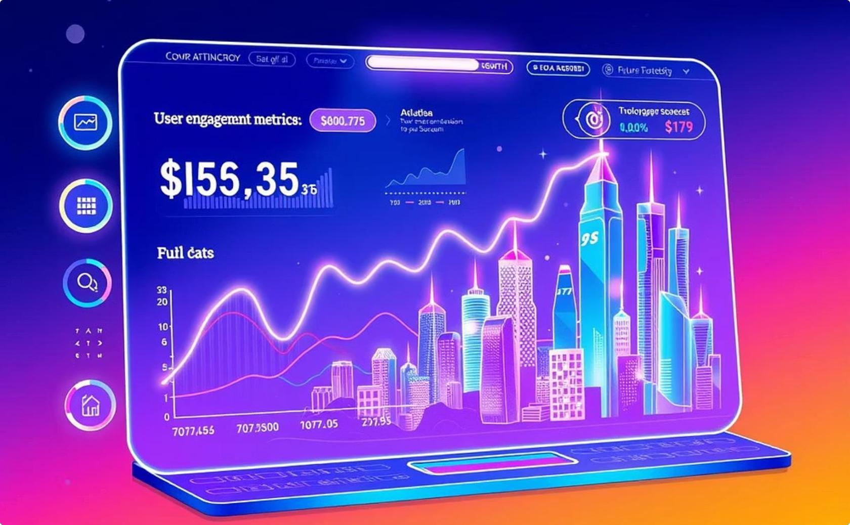
Strategic Business Objectives
Informed Acquisition Decisions
Our primary objective is to conduct an in-depth analysis of TellCo's extensive user data. This analysis provides critical insights to empower investors in making informed acquisition decisions, highlighting the intrinsic value and growth potential embedded within TellCo's user base.
Unveiling User Behavior € Trends
We meticulously identify key patterns related to user growth, engagement, overall experience, and satisfaction. By dissecting these metrics, we paint a comprehensive picture of the current user landscape and forecast future trends, ensuring a clear understanding
of TellCo's market position and operational efficiency.

Slide 3




Comprehensive Dataset Overview
Rich Data Source
We leverage one month of comprehensive Telco xDR (eXperience Data Record) data. This detailed dataset captures a wide array of user interactions, providing a granular view of network usage and service consumption.
Diverse App Usage
The dataset includes crucial information on user engagement with popular applications such as YouTube, Netflix, various gaming platforms, and a multitude of social media apps. This allows for in-depth analysis of application-specific behaviors.
Extensive Features
With over 150 features per user, the dataset offers a multi-dimensional perspective on user behavior. These features range from connection details to device specifications and service consumption patterns, enabling robust

Slide 4


Navigating Dataset Challenges
Addressing Missing Values
A common challenge in large datasets is the presence of missing values. We implemented advanced imputation techniques to ensure data integrity and prevent skewed analytical results, maintaining the robustness of our models.
Detecting Outliers in Data Streams
Significant outliers were identified in download and upload data, which could heavily influence analysis. We employed statistical methods like IQR and Z-score to detect and manage these anomalies, ensuring more accurate insights.
Essential Feature Transformation
To optimize the dataset for machine learning models, various features required transformation. This included scaling numerical features and encoding categorical variables, enhancing model performance and interpretability.

Slide 5
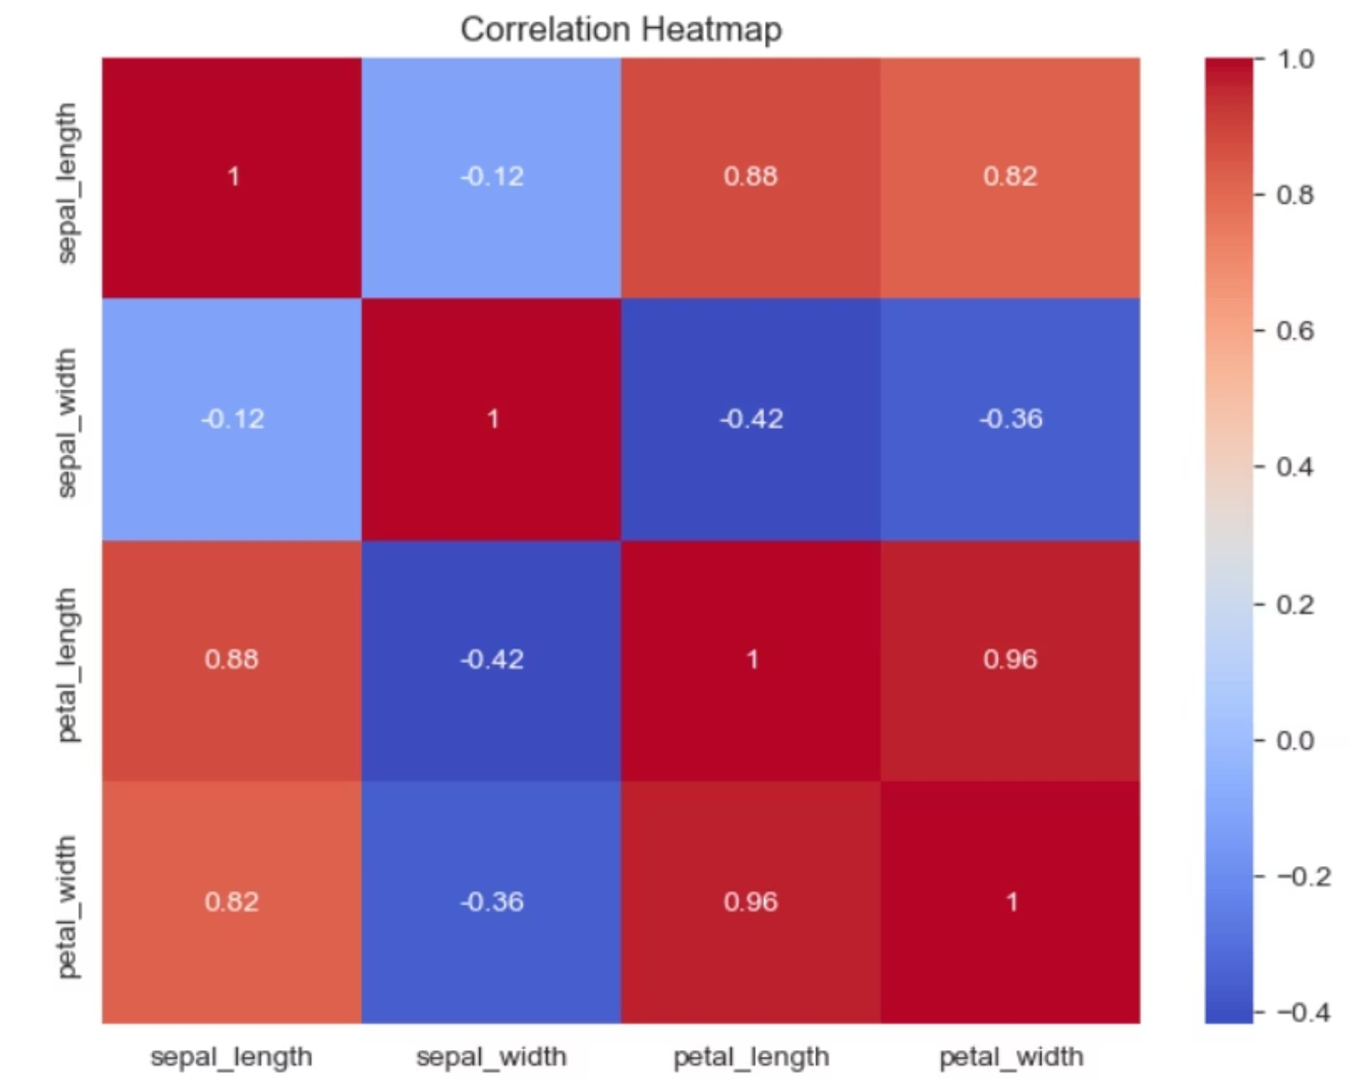
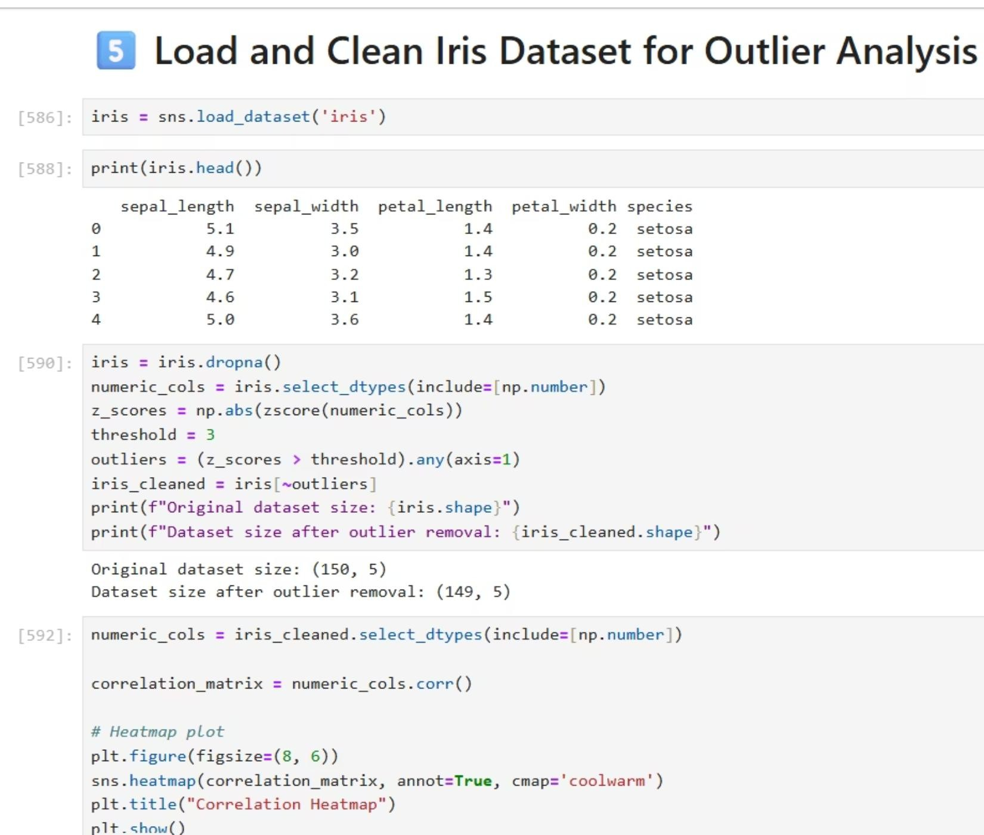
Navigating Dataset Challenges

Slide 6
User Overview: Top 10 Handsets
Overview Visualizations – Handset € Manufacturer
Understanding the most prevalent handsets among TellCo's user base provides valuable insights into device preferences and market penetration. This information can guide future marketing strategies and network optimization efforts, ensuring compatibility and enhancing user experience across the most popular devices.

Slide 7



User Overview: Top 10 Handsets
Market Insights
Understanding the most prevalent handsets provides valuable insights into market penetration and the overall distribution of TellCo's user base.
Device Preferences
This information reveals crucial device preferences among users, guiding future marketing strategies and personalized service offerings.
Network Optimization
Analyzing top handsets aids in network optimization efforts, ensuring enhanced compatibility and an improved user experience across the most popular devices.

Slide 8

Deep Dive into User Engagement Metrics
Session Frequency € Duration
We meticulously track the number of user sessions and their average duration across various applications. This metric reveals how often users engage and for how long, indicating overall stickiness and app utility.
Download and Upload Bytes
Analysis of total download and upload bytes provides insight into data consumption patterns. This highlights bandwidth demands and user reliance on specific data-intensive applications.
KMeans Clustering for Segmentation
To segment users into meaningful groups based on their behavior, we apply KMeans clustering. This powerful technique helps identify distinct user personas, enabling targeted service offerings and marketing strategies.

Slide 9
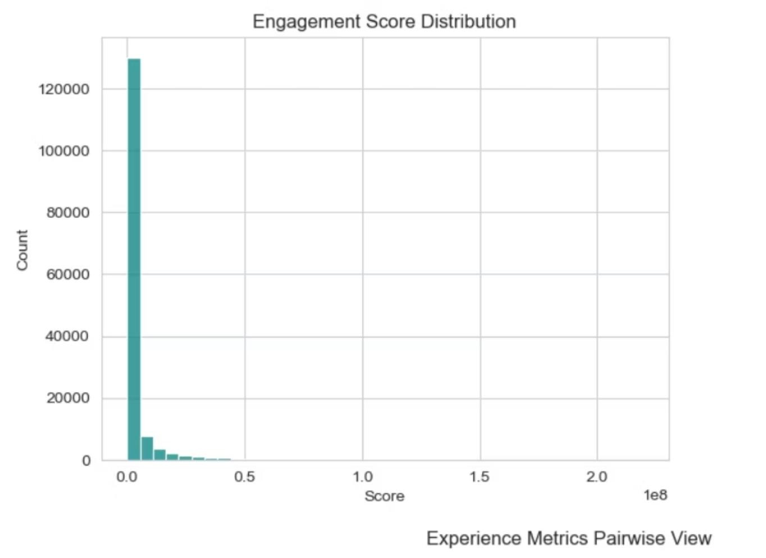
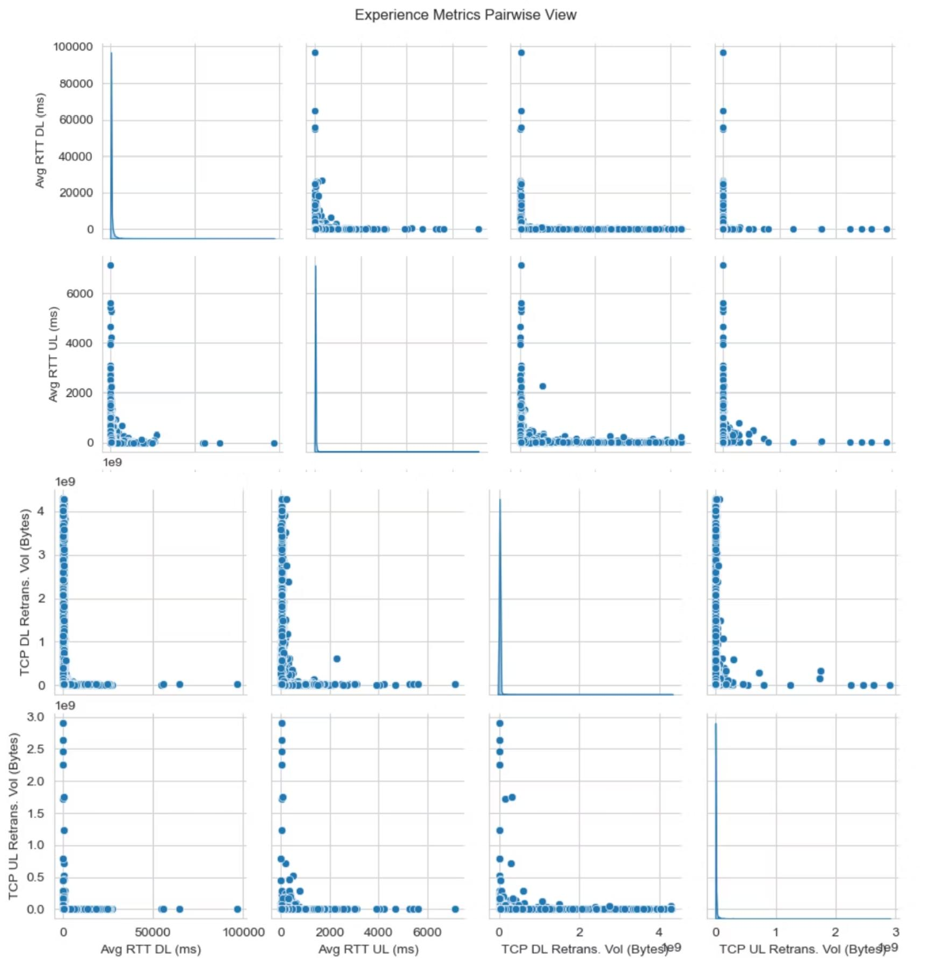
User Engagement Metrics
Distribution Analysis – Histograms € Pair Plots

Slide 10

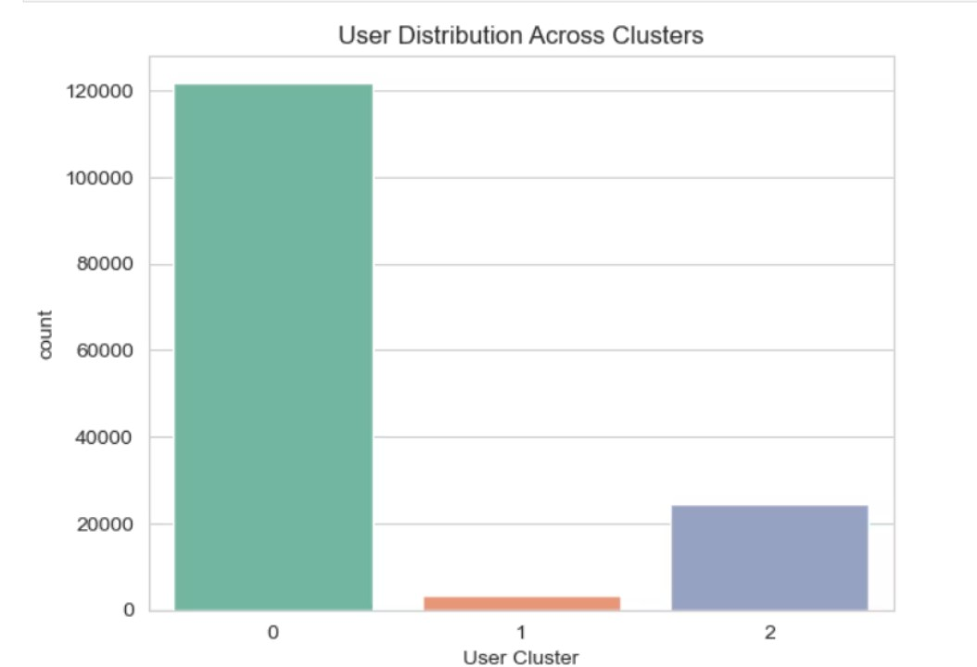

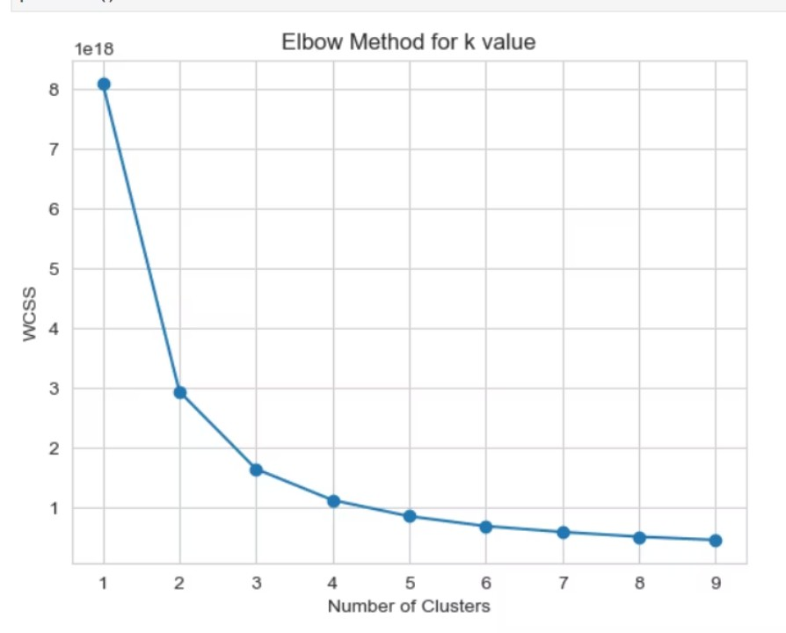
Based on the Elbow Method, 3 clusters is the optimal choice for this dataset.
Optimizing Clusters: The Elbow Method
It provides a meaningful segmentation without overfitting or increasing complexity unnecessarily.
The Elbow Method is a heuristic used in determining the number of clusters in a data set.
3
Optimal Clusters
Cluster 3 ideal segment.
Based on the Elbow method, three distinct engagement clusters were identified as optimal. This segmentation allows for precise analysis of user behaviors and tailored strategies.
Highly Engaged
Segment 1 Cluster with maximum density or size.
Users with high data consumption and frequent, long sessions. These are power users crucial for service adoption and revenue.
Moderately Engaged

Slide 11

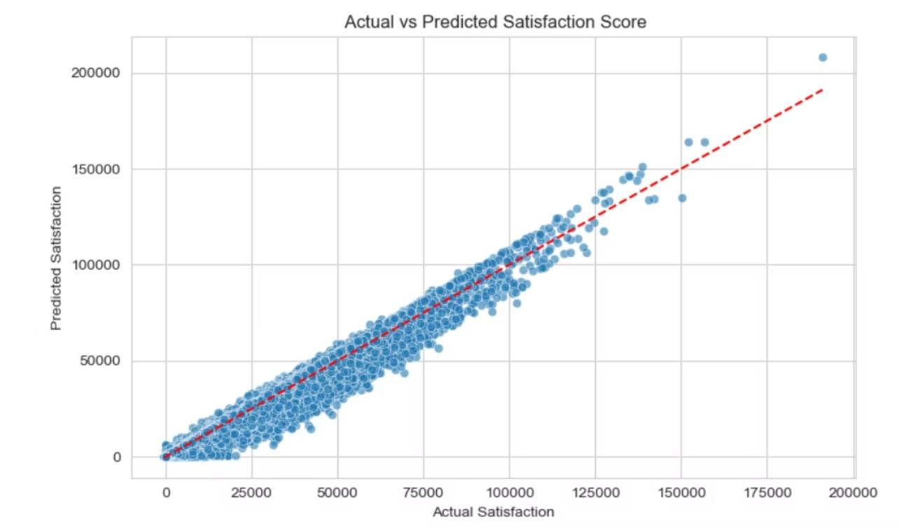
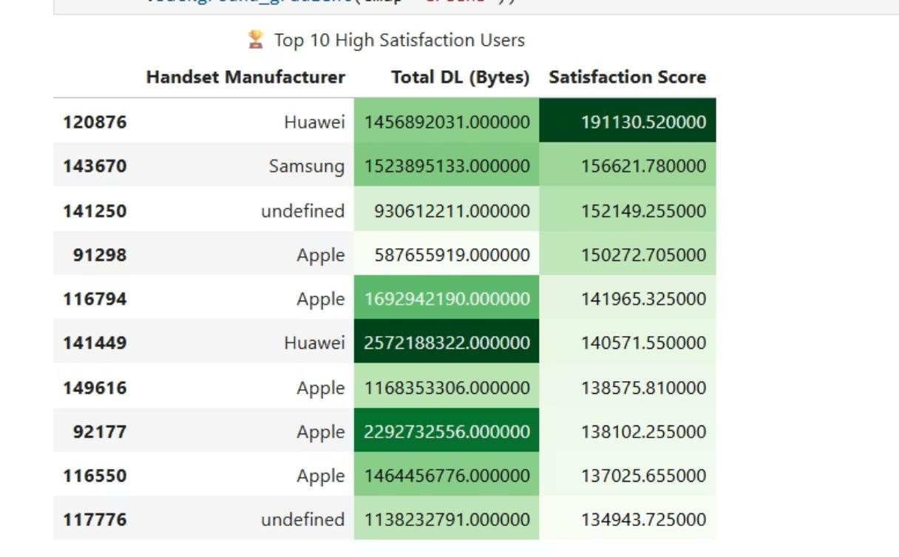
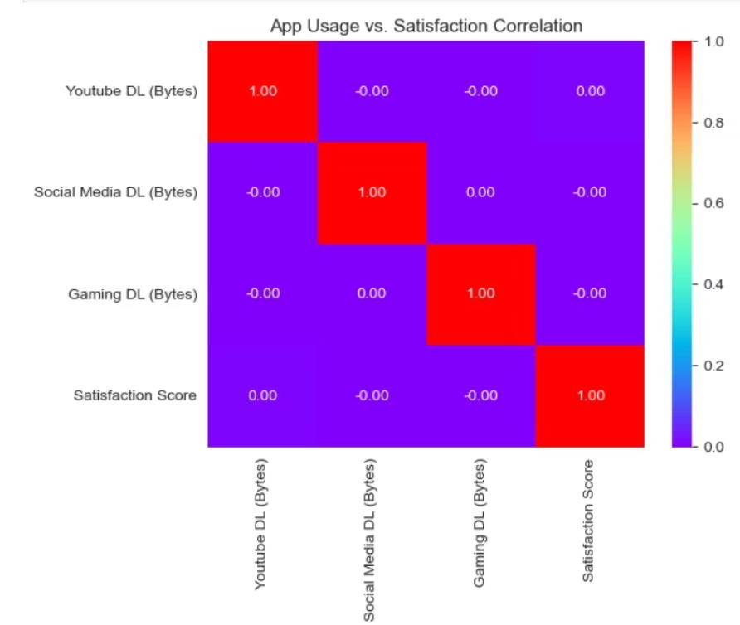
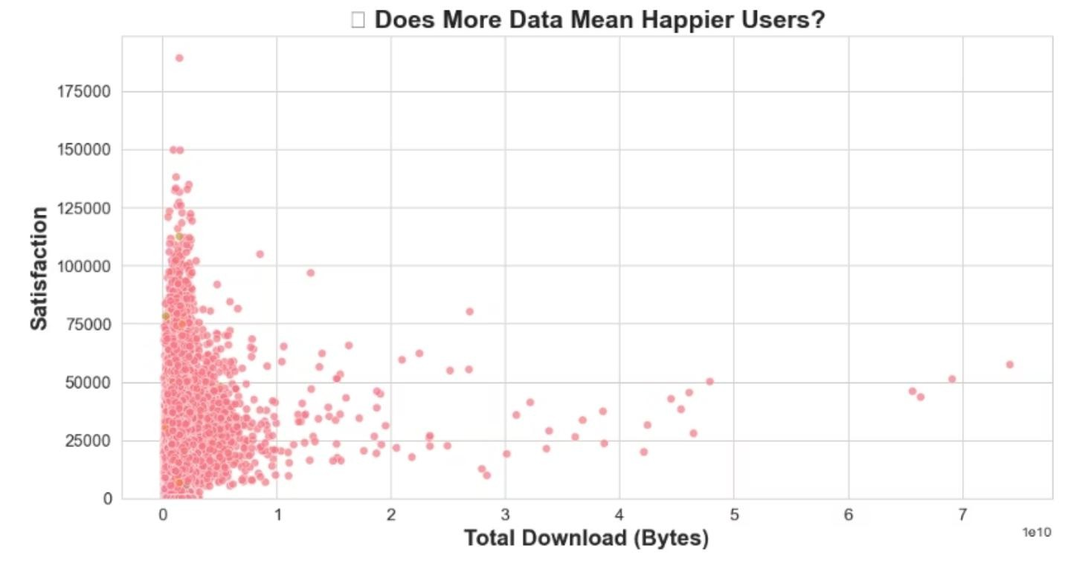
LINEAR REČRESSION – Predict Satisfaction Score from Engagement €
Top 10 High Satisfaction Users

Slide 12
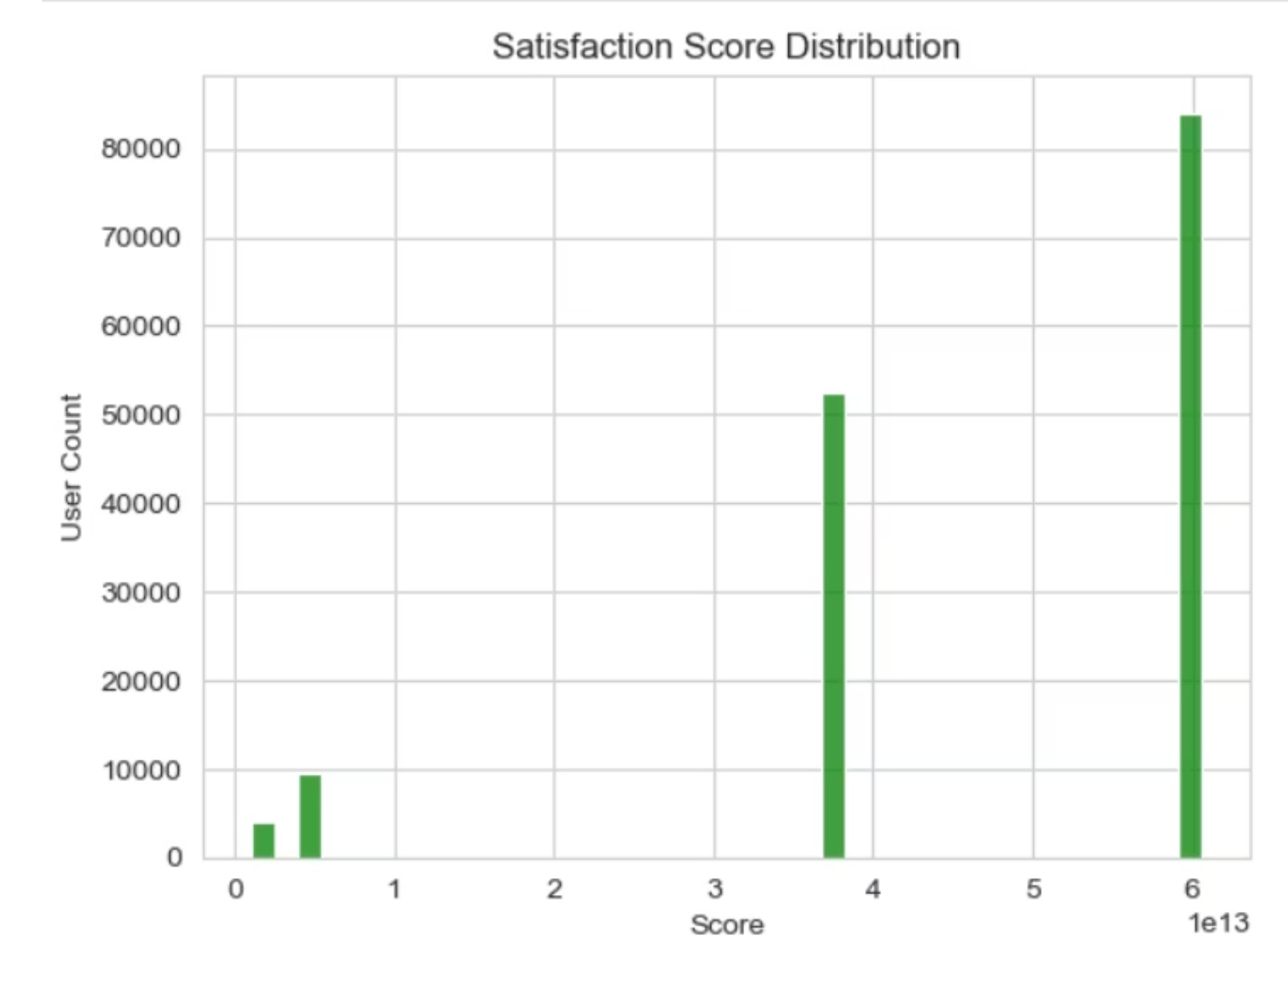
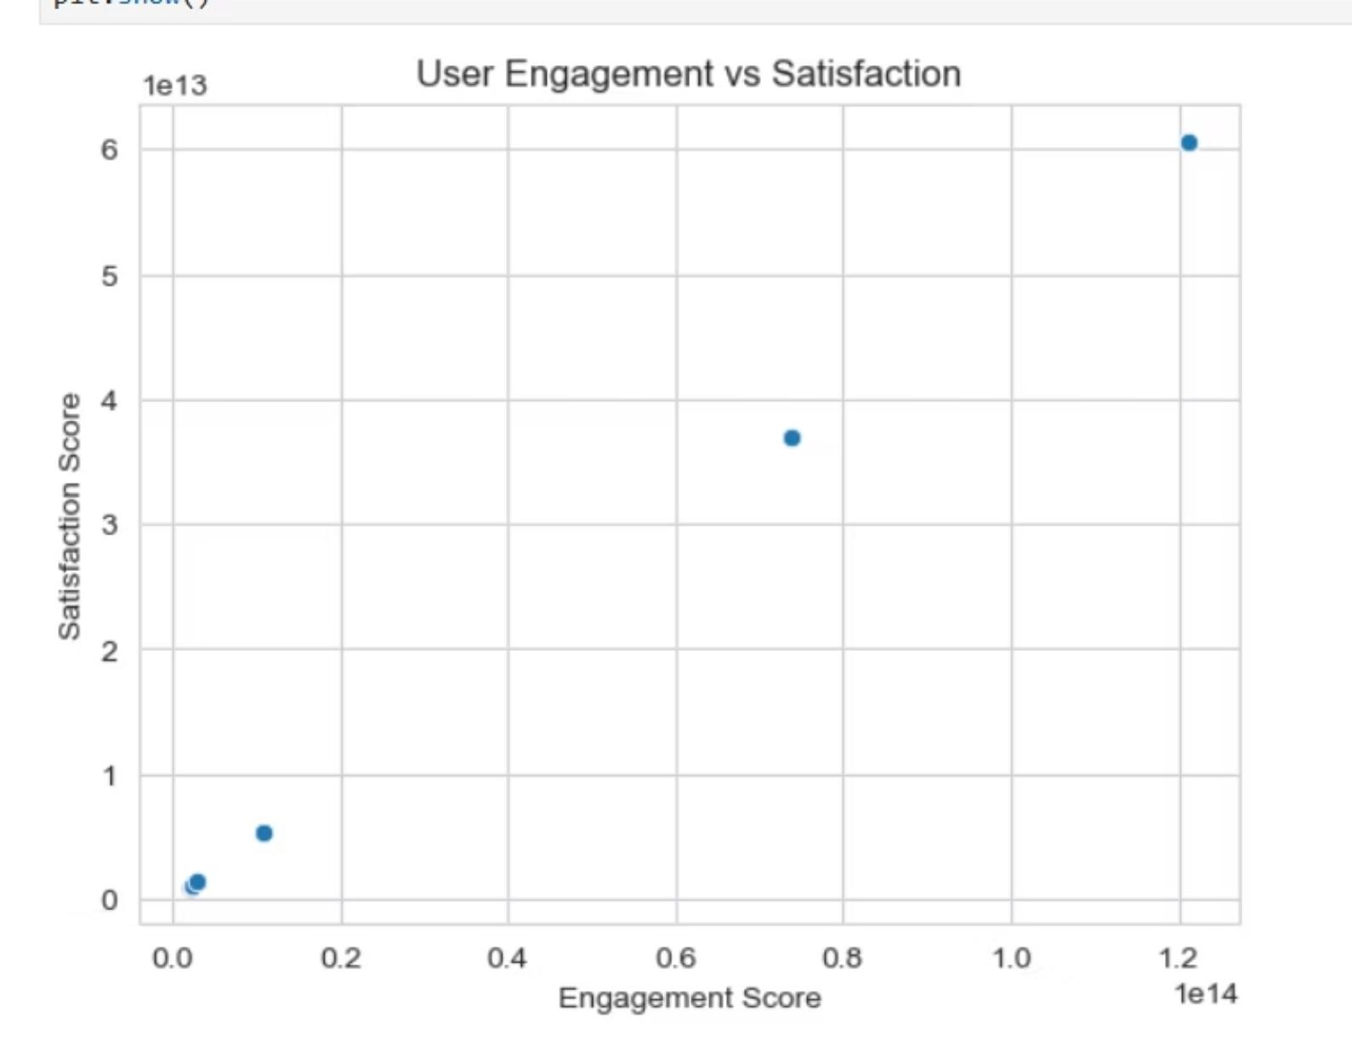
This analysis successfully performed user segmentation on telecom data using clustering and regression techniques. Users were scored based on engagement and experience, leading to a final Satisfaction Score. The processed dataset was exported to SQL Server for further analysis or integration with dashboards.
Market Share Insight

Slide 13
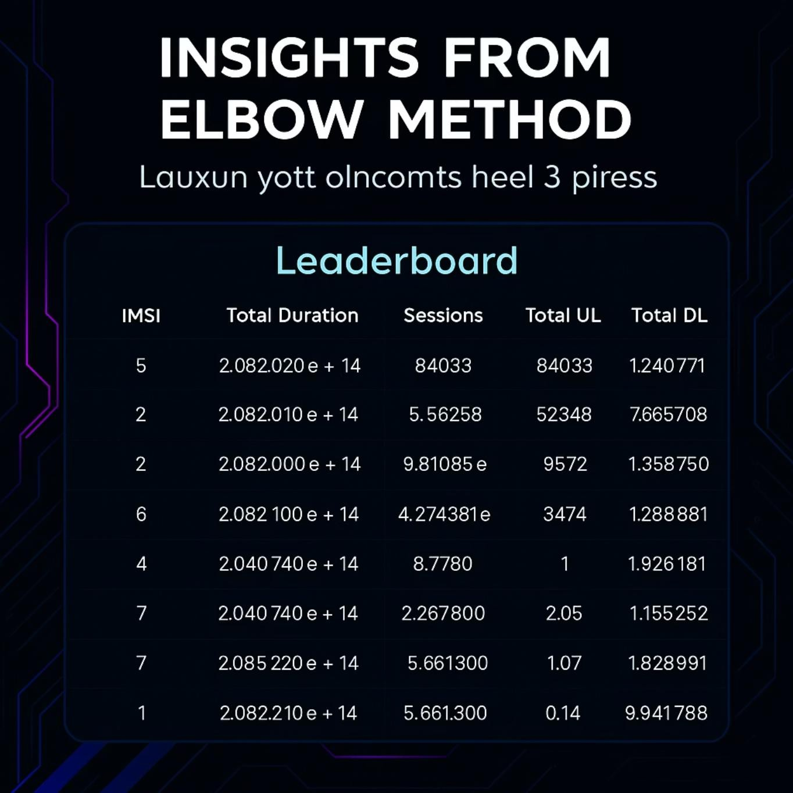
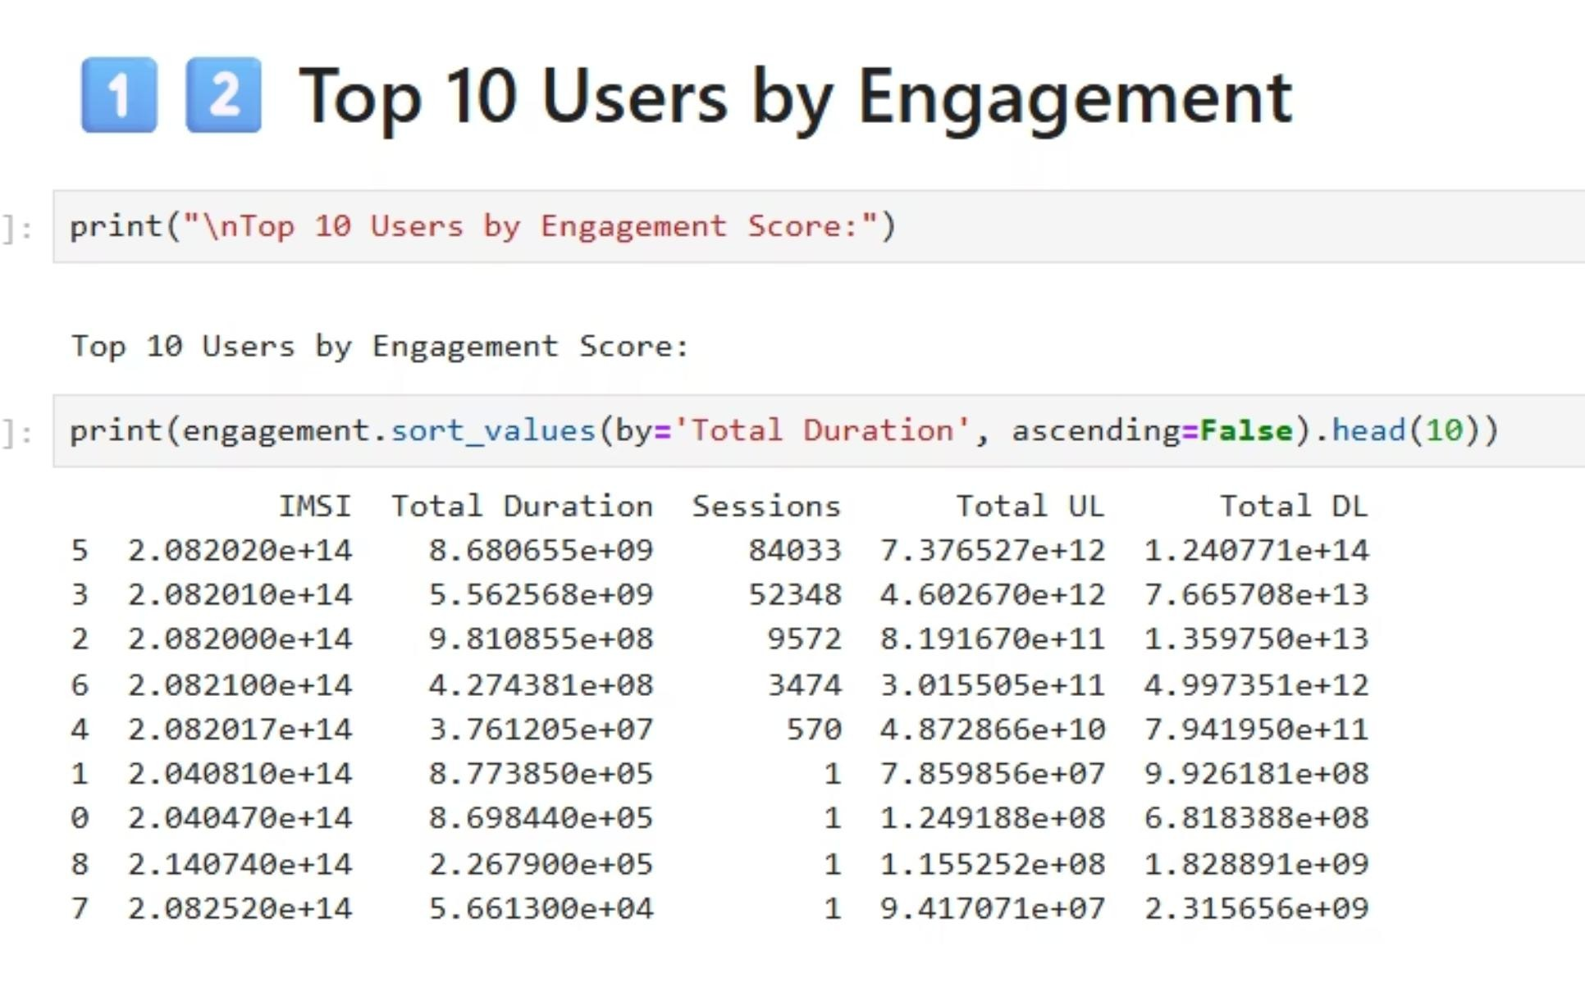
Top 10 Highly Engaged Users

Slide 14
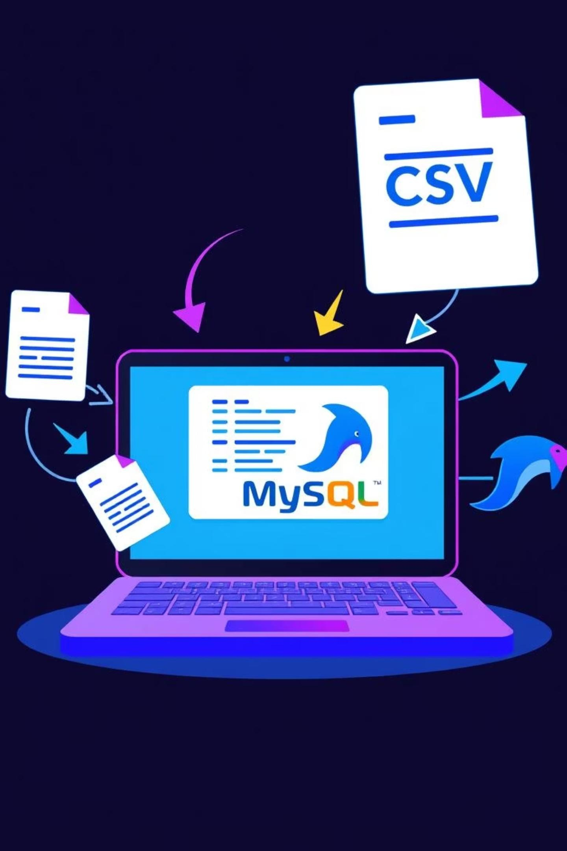
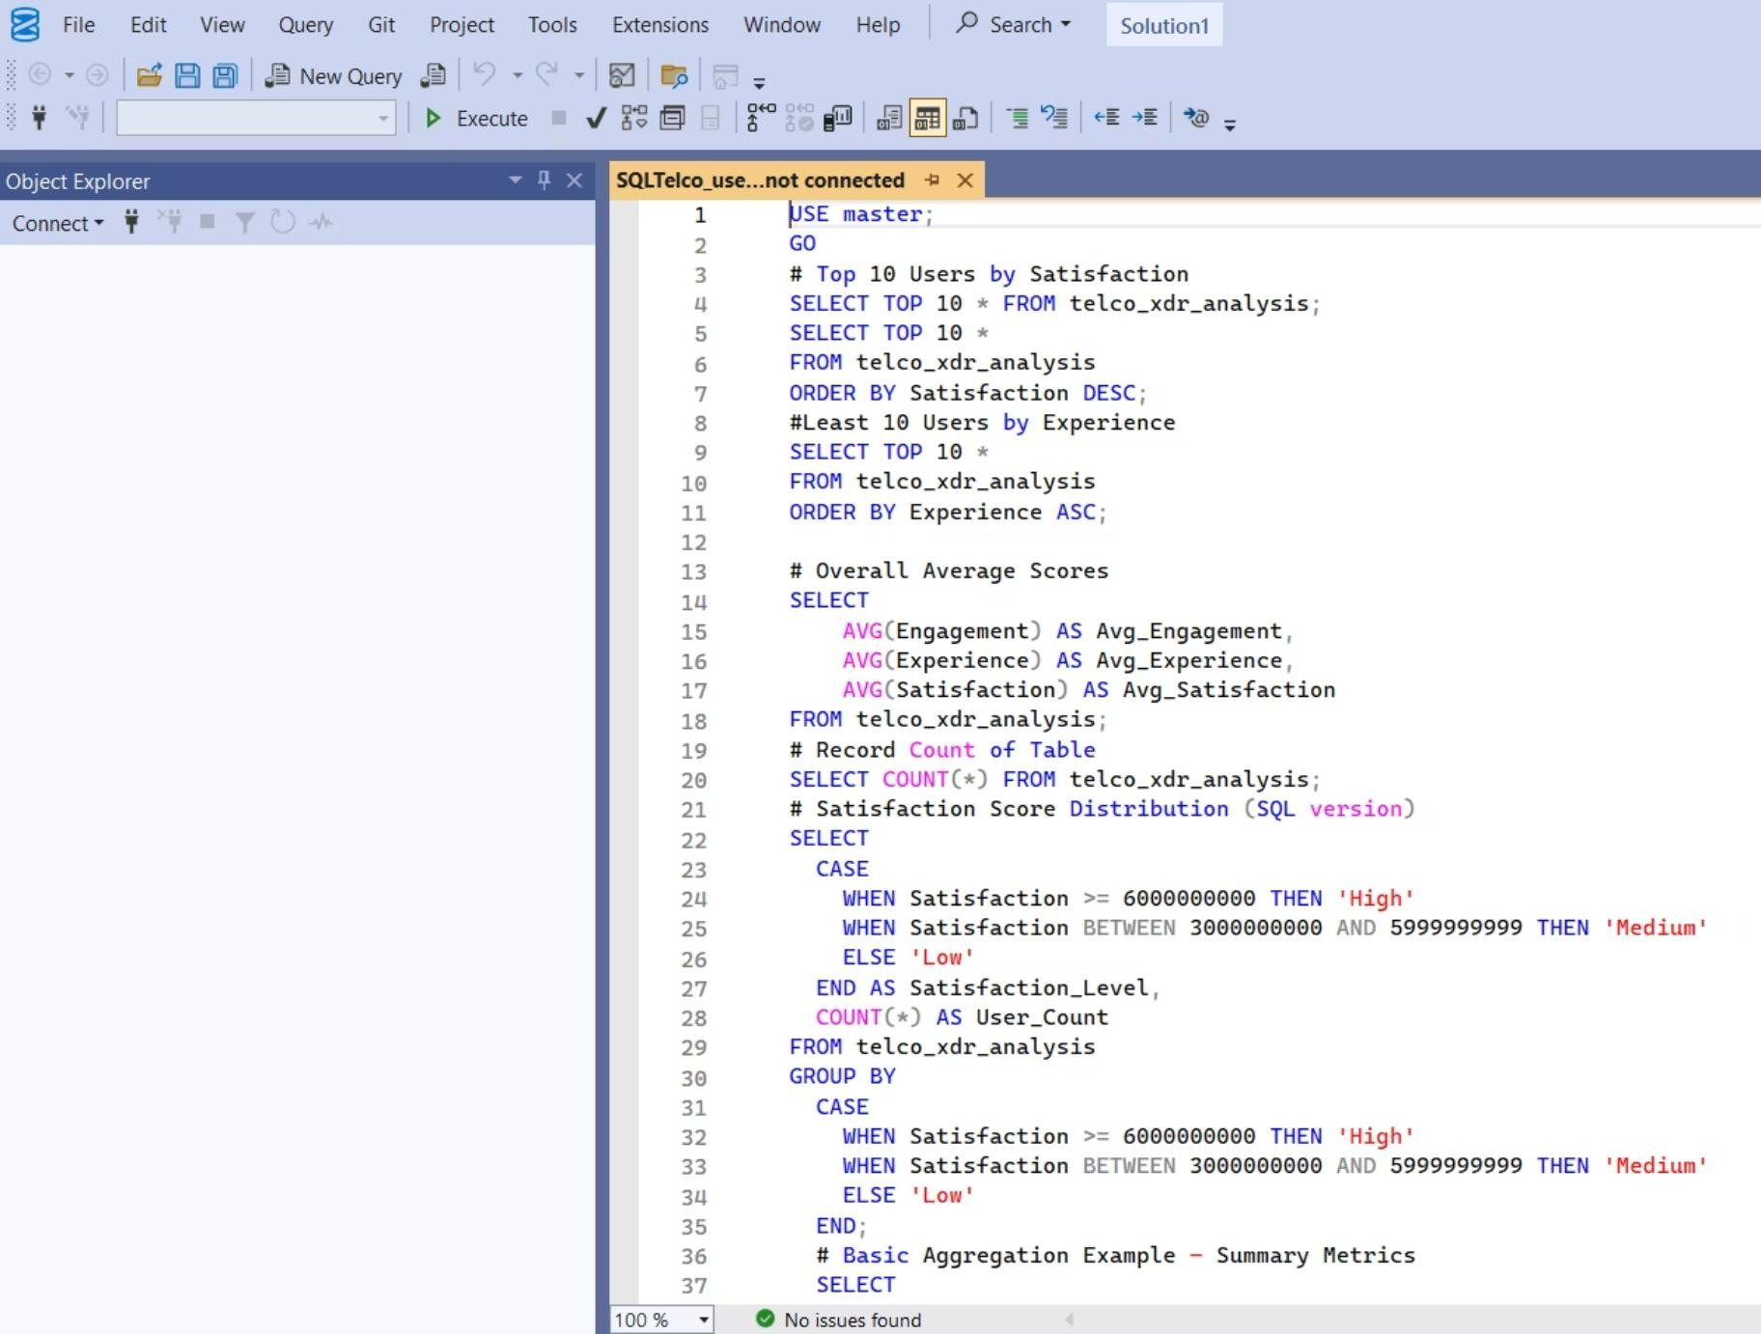
EXPORT TO MYSQL

Slide 15
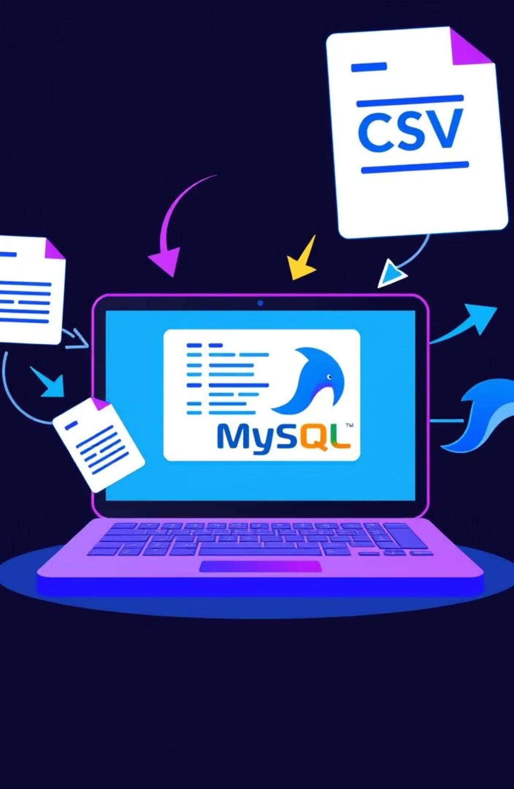
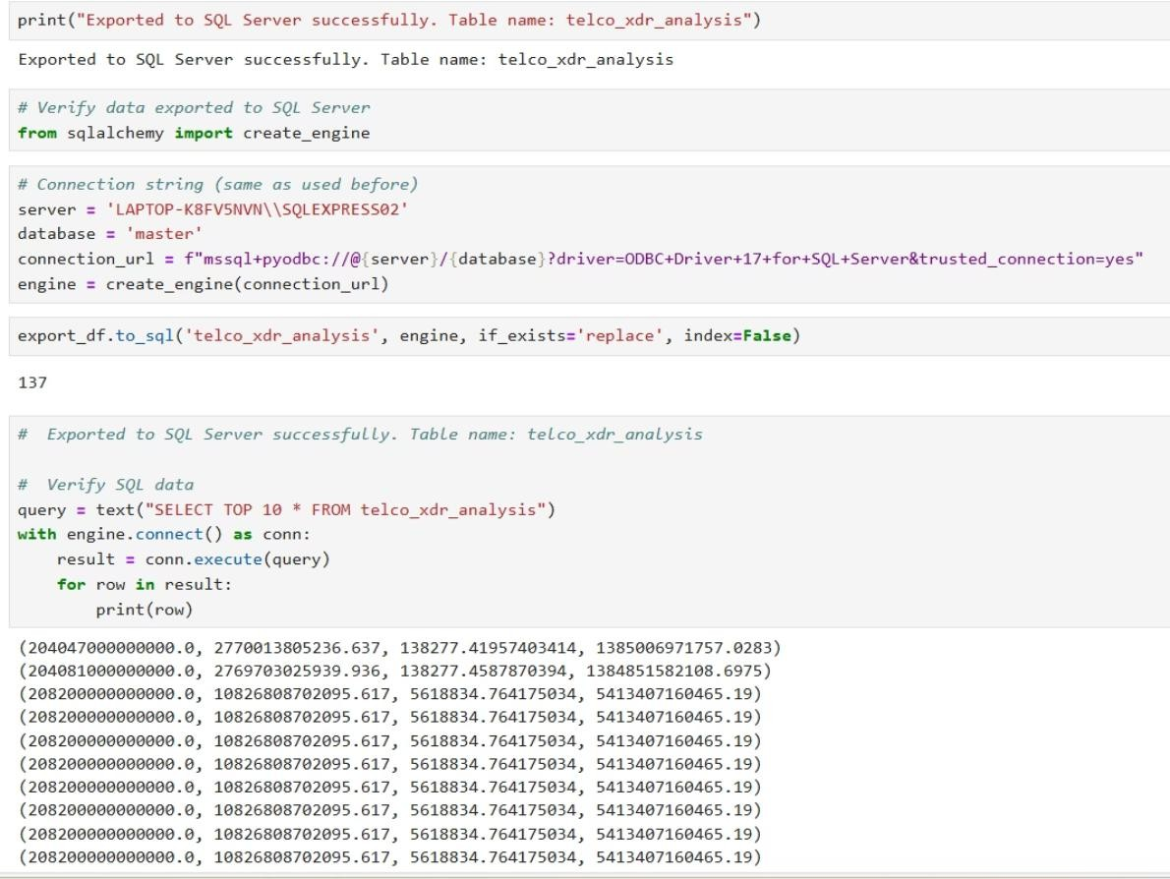
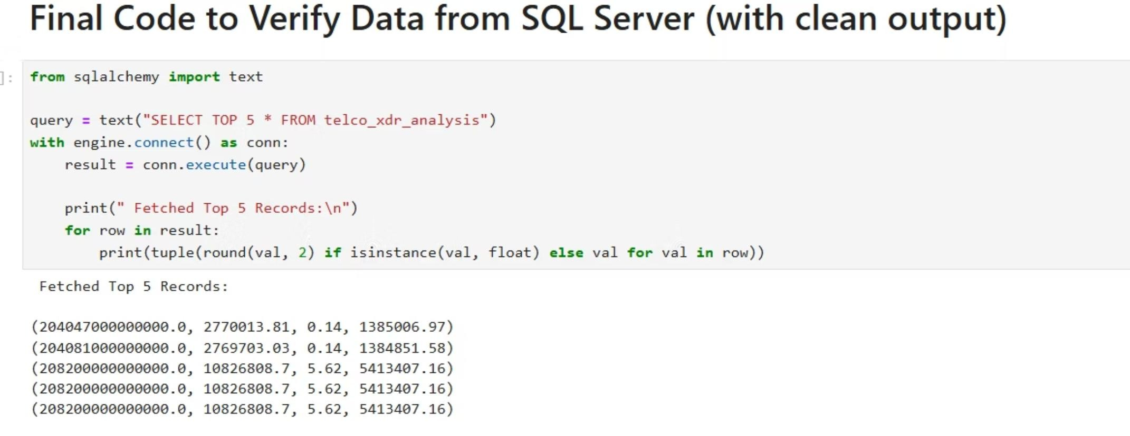
EXPORT TO MYSQL

Slide 16

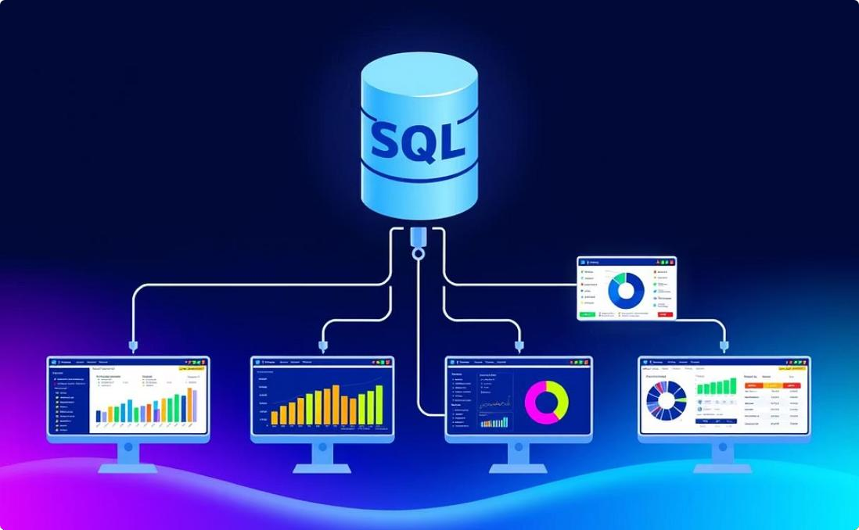

Conclusion: Analysis Summary € Next Steps
User Segmentation € Satisfaction
Data Export € Integration
The enriched dataset, including cluster segments and satisfaction scores, has been successfully exported to SQL Server for advanced querying and integration into existing BI dashboards.
Satisfaction Score Derivation
Calculated final Satisfaction Scores by evaluating user engagement and service experience, offering a unified metric for customer profiling.
Applied clustering and regression techniques on telecom user data to identify distinct behavioral groups and interaction patterns within the network.

Slide 17


Črowth Potential of the Company
Scalability € Future OutlookDataOutlook for Strategic Scale-Up
Key Strategic Črowth Levers
Strong user engagement and digital adoption show high scalability.
Satisfaction analysis signals solid customer loyalty and CLV.
Heavy data usage trends highlight platform expansion opportunities.
MySQL insight-driven decisions.
Regression confirms engagement boosts satisfaction—ideal for strategic
growth
Low churn across key clusters supports long-term investment confidence.

